Slide 1


Certification in PGP – Product Engineering
Capstone Project
Team 3​ - PDP
11-Dec-2023​

Slide 2
AGENDA
Team Introduction​
Task Ownership
Capstone Project overview​
Capstone Project solution design & solution implementation
Use Case / ​Sequence / Class Diagrams
API Documentation
Code Repository
UI Screenshots
Challenges & errors encountered during solution design​

Slide 3
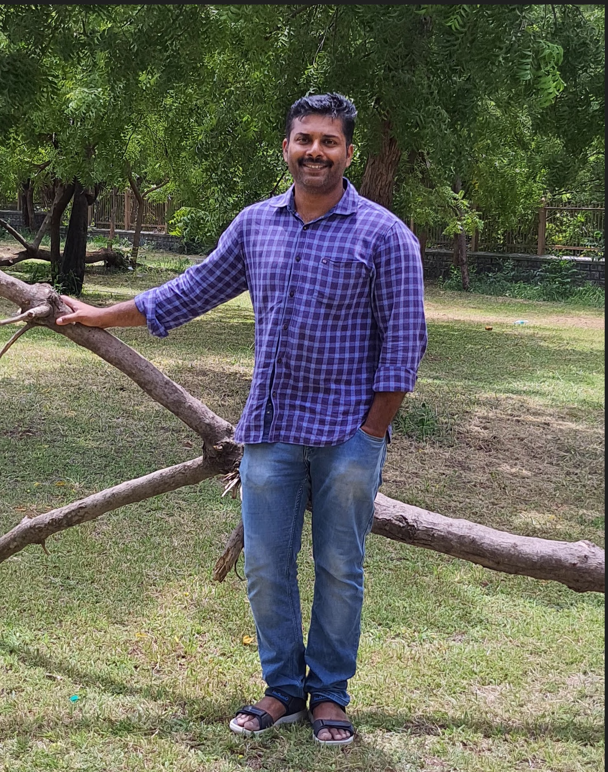
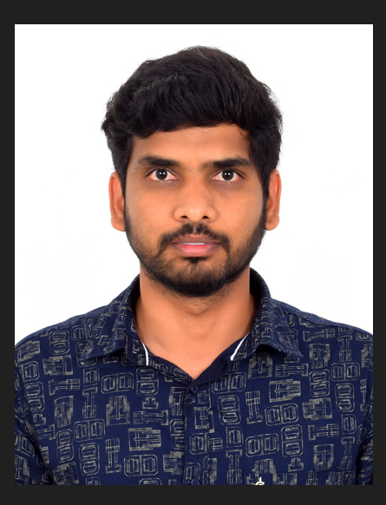
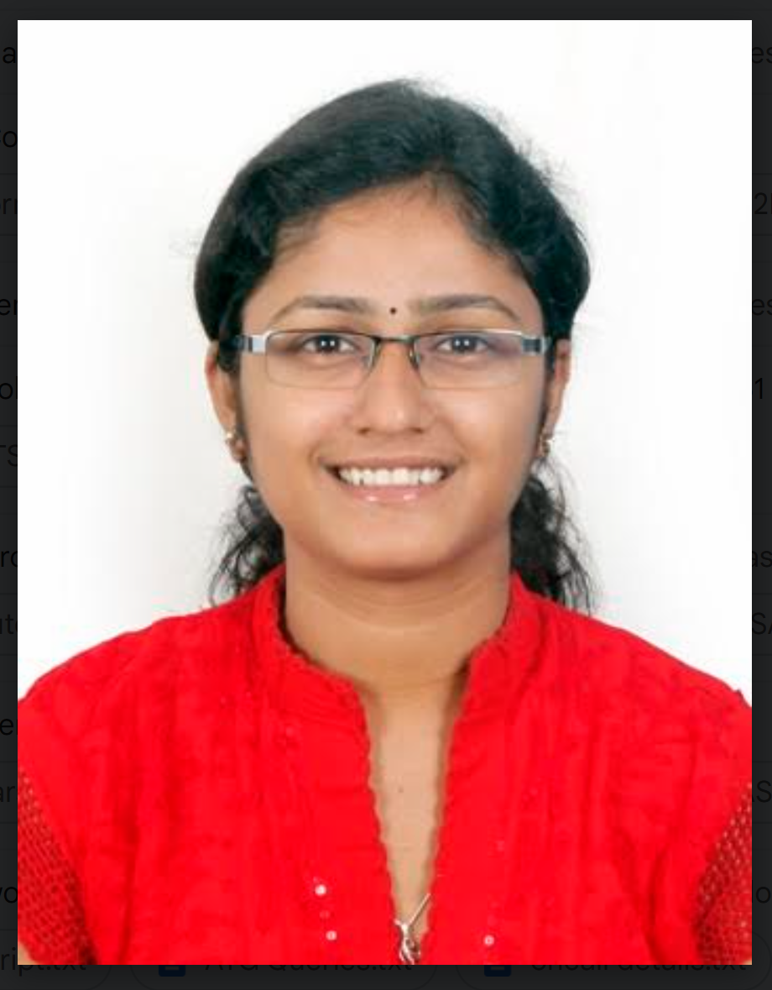
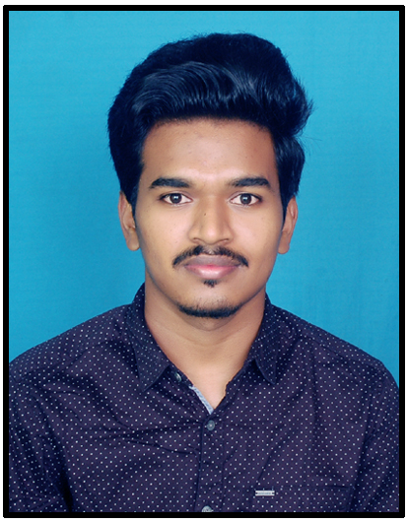
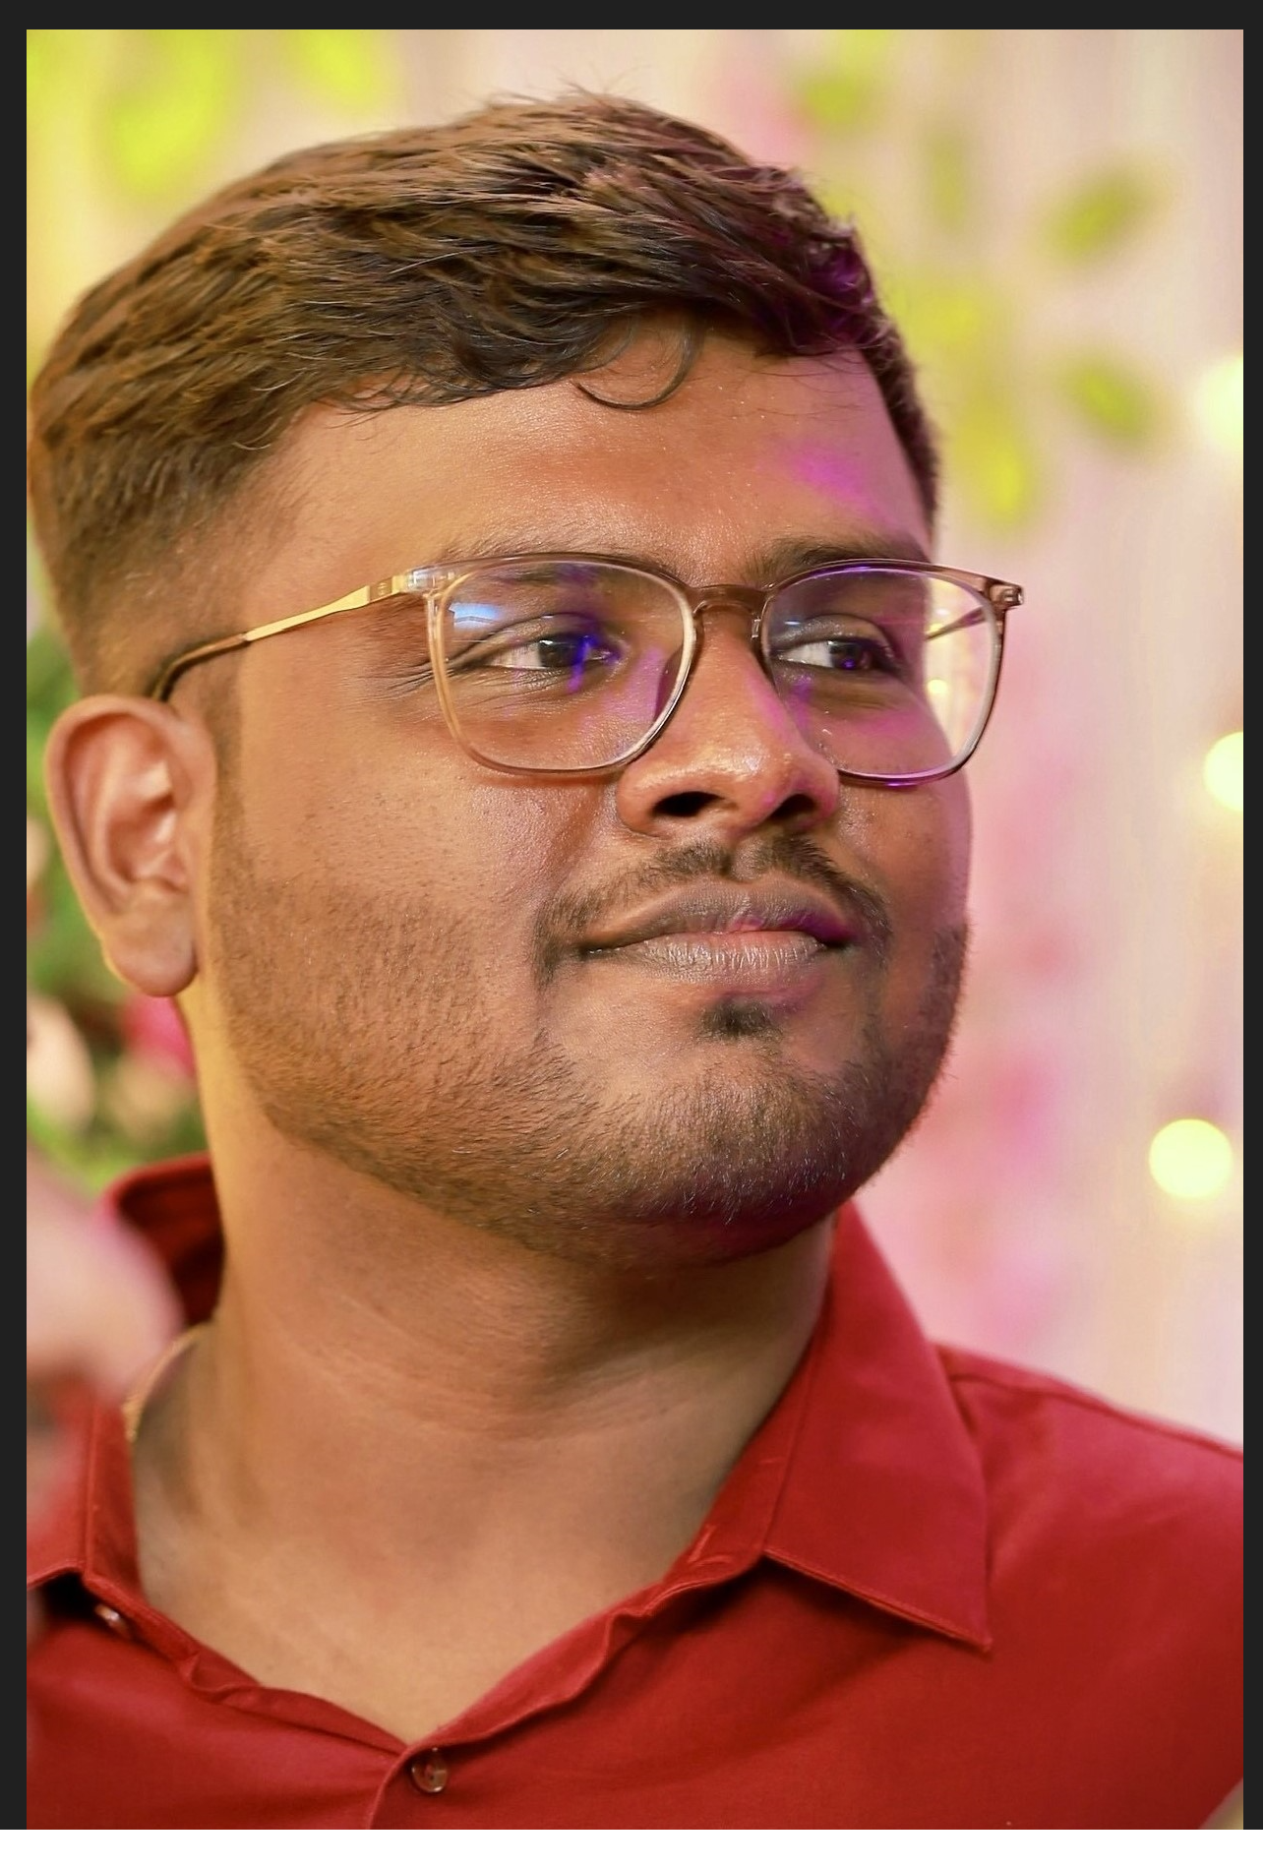
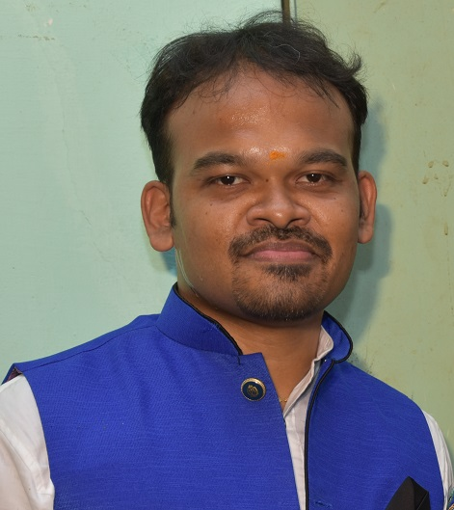
Team Members
Arun Sreekantan
Senior Technology Services Engineer
Frontend Developer
Gowtham Marappan
Senior Technology Services Engineer
Backend Developer
Harshini S
Technology Services Engineer III
Backend Developer
Maruthi Kumar
Systems and Infrastructure Engineer II
Backend Developer
Joshua Raththesh S
Technology Services Engineer III
Backend Developer
Jayakumar Inbaraj
Manager Technology Services Engineering Backend Developer

Slide 4
Task Ownership
S.No | Action Items | Owners
1 | User Story : Accessing Comprehensive Product Information | Harshini S
2 | User Story : Universal Access to Product Details | Harshini S / Joshua Raththesh S
3 | User Story : Adding Product to Cart with User Login | Joshua Raththesh S
4 | User Story : Saving Products for Later as Logged-In User | Gowtham Marappan
5 | User Story : Comparing Products and Reviews | K Maruthi Kumar
6 | Front-End Development | Arun Sreekantan
7 | Test cases and Testing config | Harshini S
8 | Mongo DB Configuration & Documents to add | Harshini S
9 | Dockerization | Harshini S
10 | Jenkins | K Maruthi Kumar / Harshini S
11 | Eureka server and Zuul cloud gateway local check | Harshini S
12 | Backend Code integration with Team 2 and Team 10 | Harshini S
13 | Frontend Code integration with Team 2 and Team 10 | Arun Sreekantan
14 | Deployment on Cloud | Harshini S
15 | API / Dockerization / Confluence / PPT Documentation | Harshini S
16 | Requirements Gathering | Jayakumar Inbaraj

Slide 5
Capstone Project Overview
This Capstone project is organized to deliver an Online Shopping platform called Wall-E-Cart. The platform aims to provide a seamless shopping experience for customers and streamline the post-transaction processes for the administrators ​
This Online shopping platform is split into 10 modules for 10 teams​
We are from Team 3 who represents the Item Page and its relevant modules​
Item page has detailed product pages providing comprehensive information about each item including specifications, reviews, and related products.​
We are covering following user stories to complete the project.​
Accessing Comprehensive Product Information ​
Adding Product to Cart with User Login ​
Universal Access to Product Details​
Saving Products for Later as a Logged-In User​
Comparing Products and Reviews ​

Slide 6
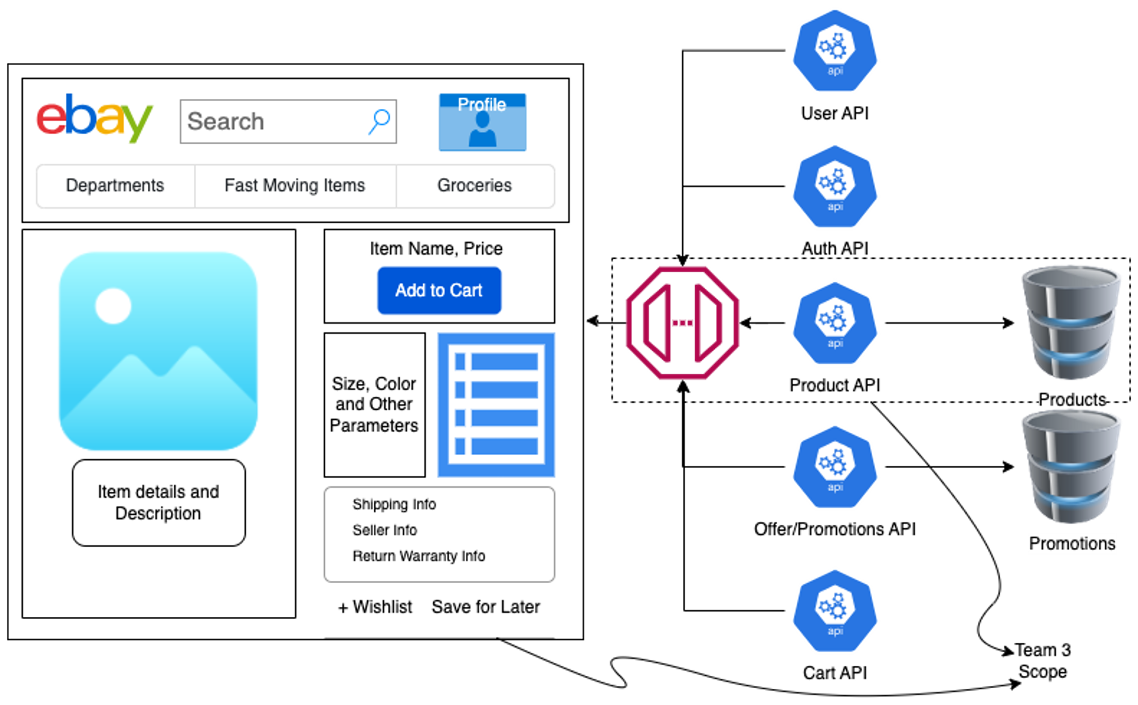
Capstone Project solution design​

Slide 7

Implementation
Case study & Design
Technical Highlights
PDP Application
What’s Done More
Integrating Search & Dashboard Services with PDP
Accessing Comprehensive Product Information ​
Adding Product to Cart with User Login ​
Universal Access to Product Details​
Saving Products for Later as a Logged-In User​
Comparing Products and Reviews ​
Expose PDP as a service
Build a complete app by Integrating FE & BE services
Dockerization
Jenkins – CI & CD
Integration
Eureka Service Registration
Junit/ Mockito Integration
Zuul cloud gateway integration
Spingboot 3.1.4
React JS 18.2.0
Mongo DB
Eureka Server
Docker
Jenkin
Mockito/Junit
Zuul Cloud gateway
Invoke login service & Add to the cart for the logged in user
Invoke login service & Wishlist a product for the logged in user
Pass the product id if we click on an item after performing search operation

Slide 8
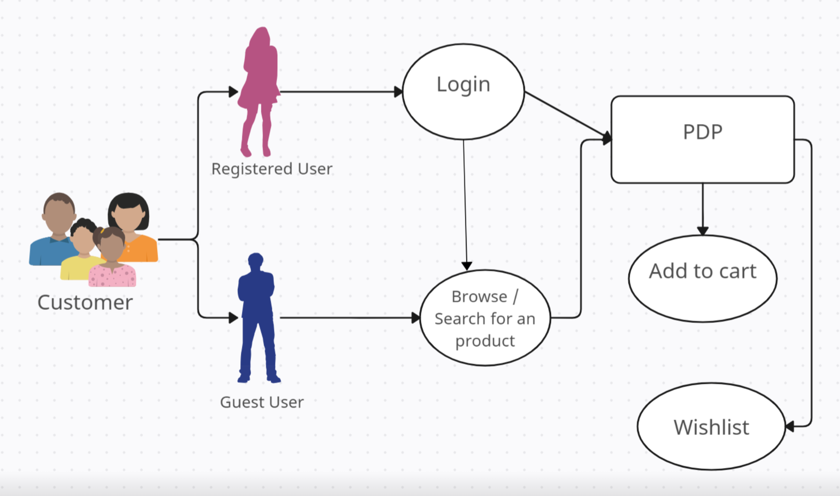
Use Case Diagram

Slide 9
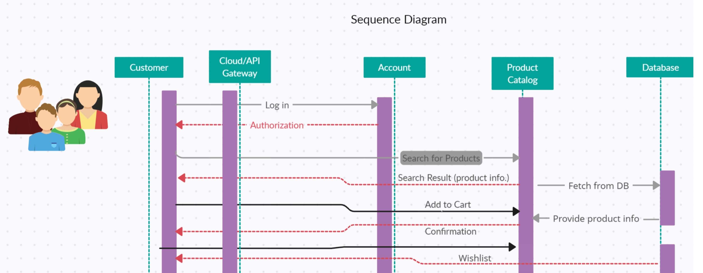
Sequence Diagram

Slide 10
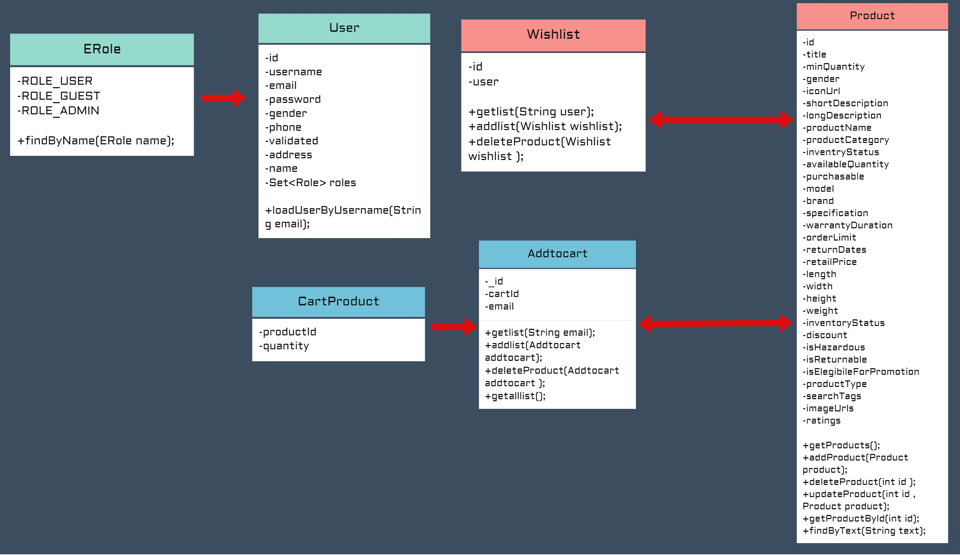
Class Diagram

Slide 11
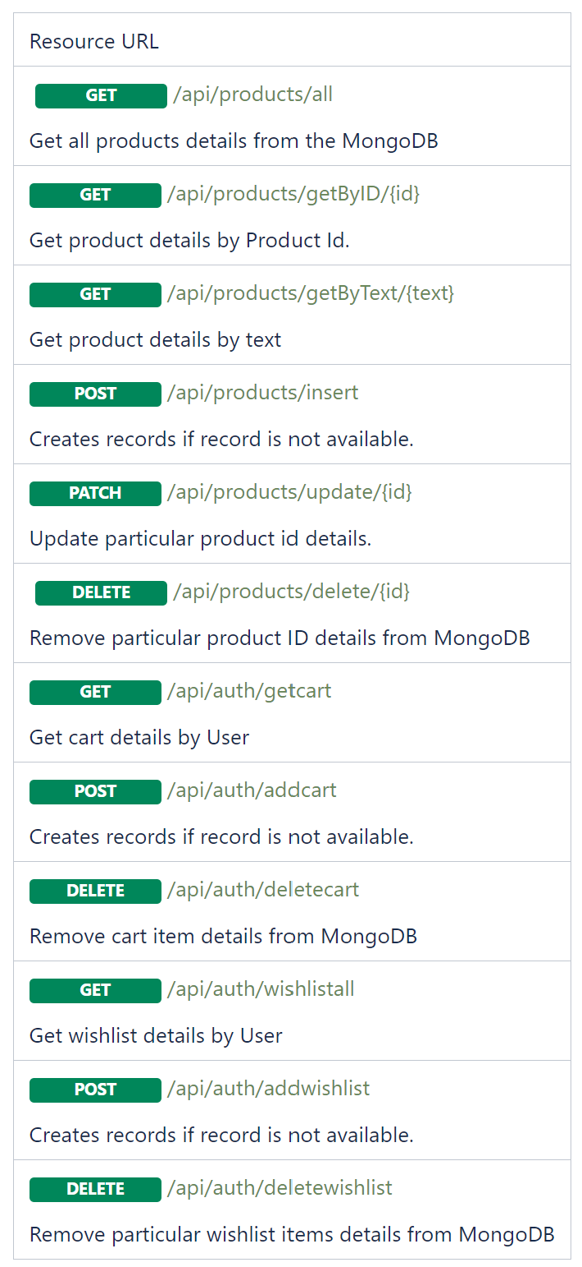
API Documentation
We have documented the Request and Response in below confluence page for further details.
https://confluence.walmart.com/display/~h0s0464/Product+API%27s

Slide 12


Code Repository
Team 3 code repository for Item page and its relevant functionalities are tracked under following GitHub page​
https://github.com/walmart-2023-sep-ascend/Team03-Frontend
https://github.com/walmart-2023-sep-ascend/pdp_team03_backend ​

Slide 13
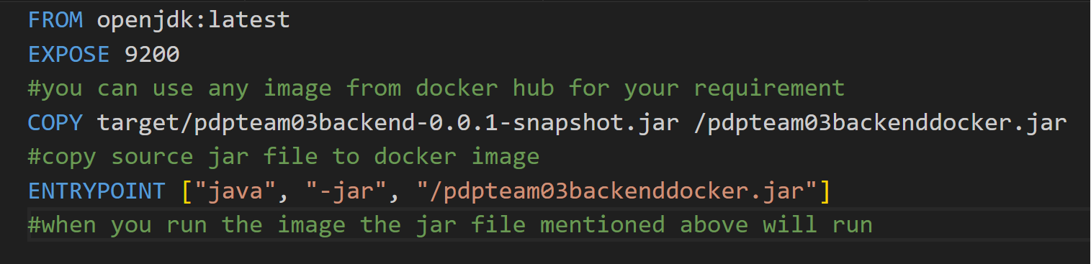
Team 3 - Backend Docker File

Slide 14
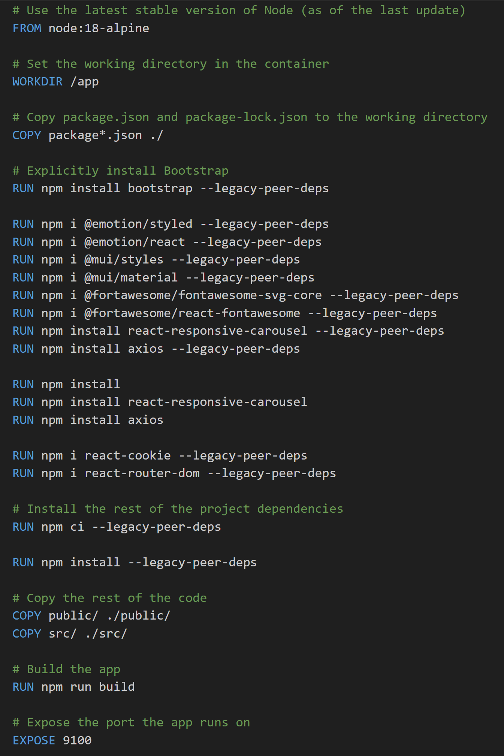
Team 2/3/10 - Frontend Docker File

Slide 15
Team 3 - Docker Image Commands
To create docker image in local
C:\Users\h0s0464\Documents\GitHub\pdp_team03_backend>docker build -t pdpapplicationbackendteam03 .
C:\Users\h0s0464\Documents\GitHub\pdp_team03_backend>docker container run --network ascend-pgp-team2-network --name team3-backend-container-1 -p 9200:9200 -d pdpapplicationbackendteam03
Push docker image from local to docker hub
C:\Users\h0s0464\Documents\GitHub\pdp_team03_backend>docker images
C:\Users\h0s0464\Documents\GitHub\pdp_team03_backend>docker image tag pdpapplicationbackendteam03 harshinisuresh/pdpapplicationbackendteam03
C:\Users\h0s0464\Documents\GitHub\pdp_team03_backend>docker push harshinisuresh/pdpapplicationbackendteam03
To pull docker images to Azure linux server
ssh -i "C:\Users\h0s0464\Documents\GitHub\team3productdetailsvm_key.pem" 172.203.226.233
sudo docker pull harshinisuresh/pdpapplicationbackendteam03:latest
sudo docker run -p 9200:9200 harshinisuresh/pdpapplicationbackendteam03 .
Application is deployed in cloud & is accessible via below URL
UI: http://ascend-pgp-team2.eastus.cloudapp.azure.com:9100/Dashboard/rcornehl7@mozilla.com?
BE: http://172.203.226.233:9200/api/products/getByID/4

Slide 16
Docker Commands to pull docker image of Team 2 & 10
docker pull mouli2282/team2-backend-image:0.0.4
docker pull mouli2282/eurekha-server:0.0.1
docker pull mouli2282/zuul-api-cloud-gateway:0.0.4
docker pull s0k05sw/userdashboard:4.0
docker pull mouli2282/team2-frontend-image:1.0.0
docker network create ascend-pgp-team2-network
docker container run --network ascend-pgp-team2-network --name eurekha-server-container -p 8761:8761 -d mouli2282/eurekha-server:0.0.1
docker container run --network ascend-pgp-team2-network --name zuul-api-cloud-gateway -p 8765:8765 -d mouli2282/zuul-api-cloud-gateway:0.0.5
docker container run --network ascend-pgp-team2-network --name team2-backend-container-1 -p 9010:9010 -d mouli2282/team2-backend-image:0.0.4
docker container run --network ascend-pgp-team2-network --name team10-backend-container-1 -p 9903:9903 -d s0k05sw/userdashboard:4.0
docker container run --name team3-backend-container-1 -p 9100:9100 -d mouli2282/team2-frontend-image:1.0.0

Slide 17
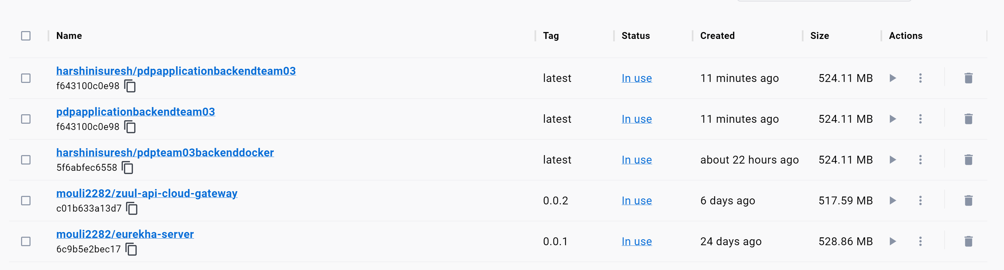
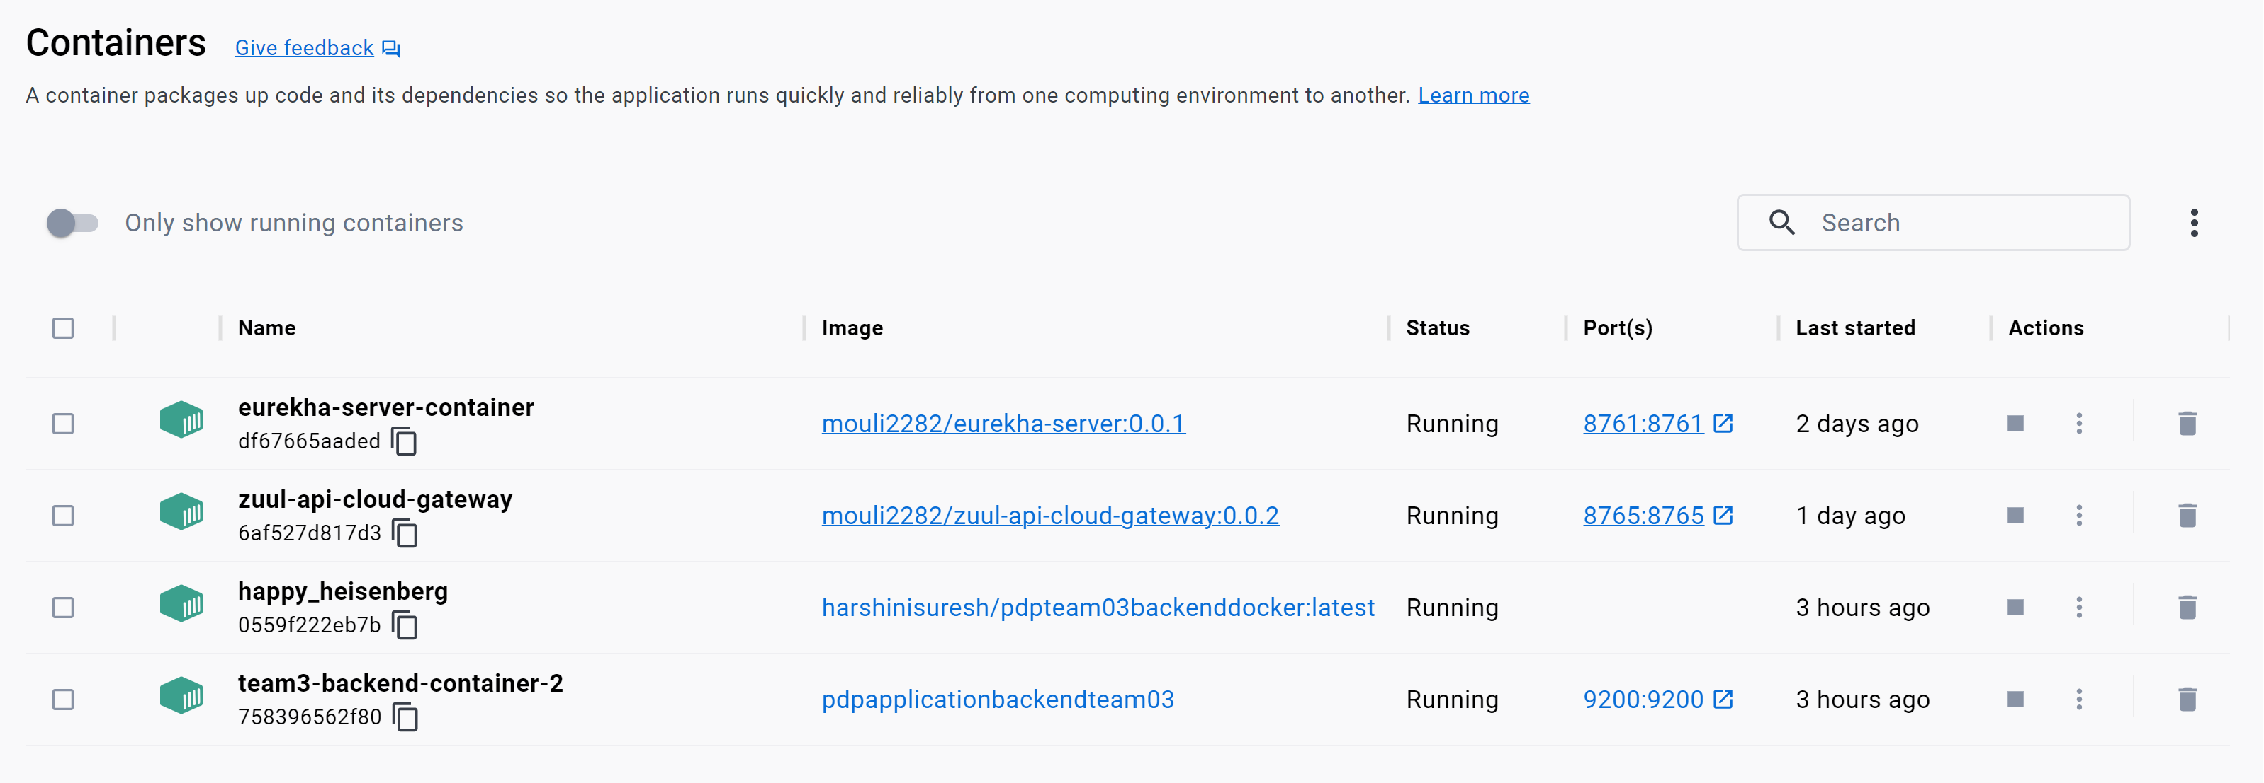
Dockerization – Image & Container

Slide 18
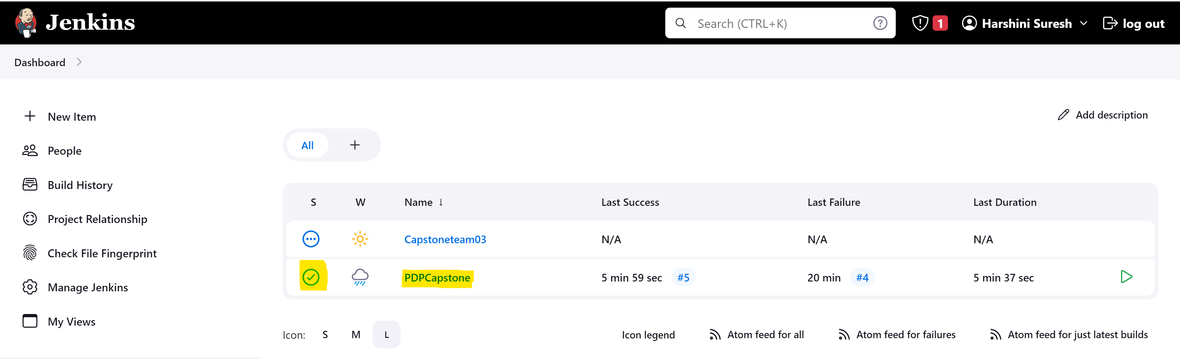
Jenkins Dashboard

Slide 19
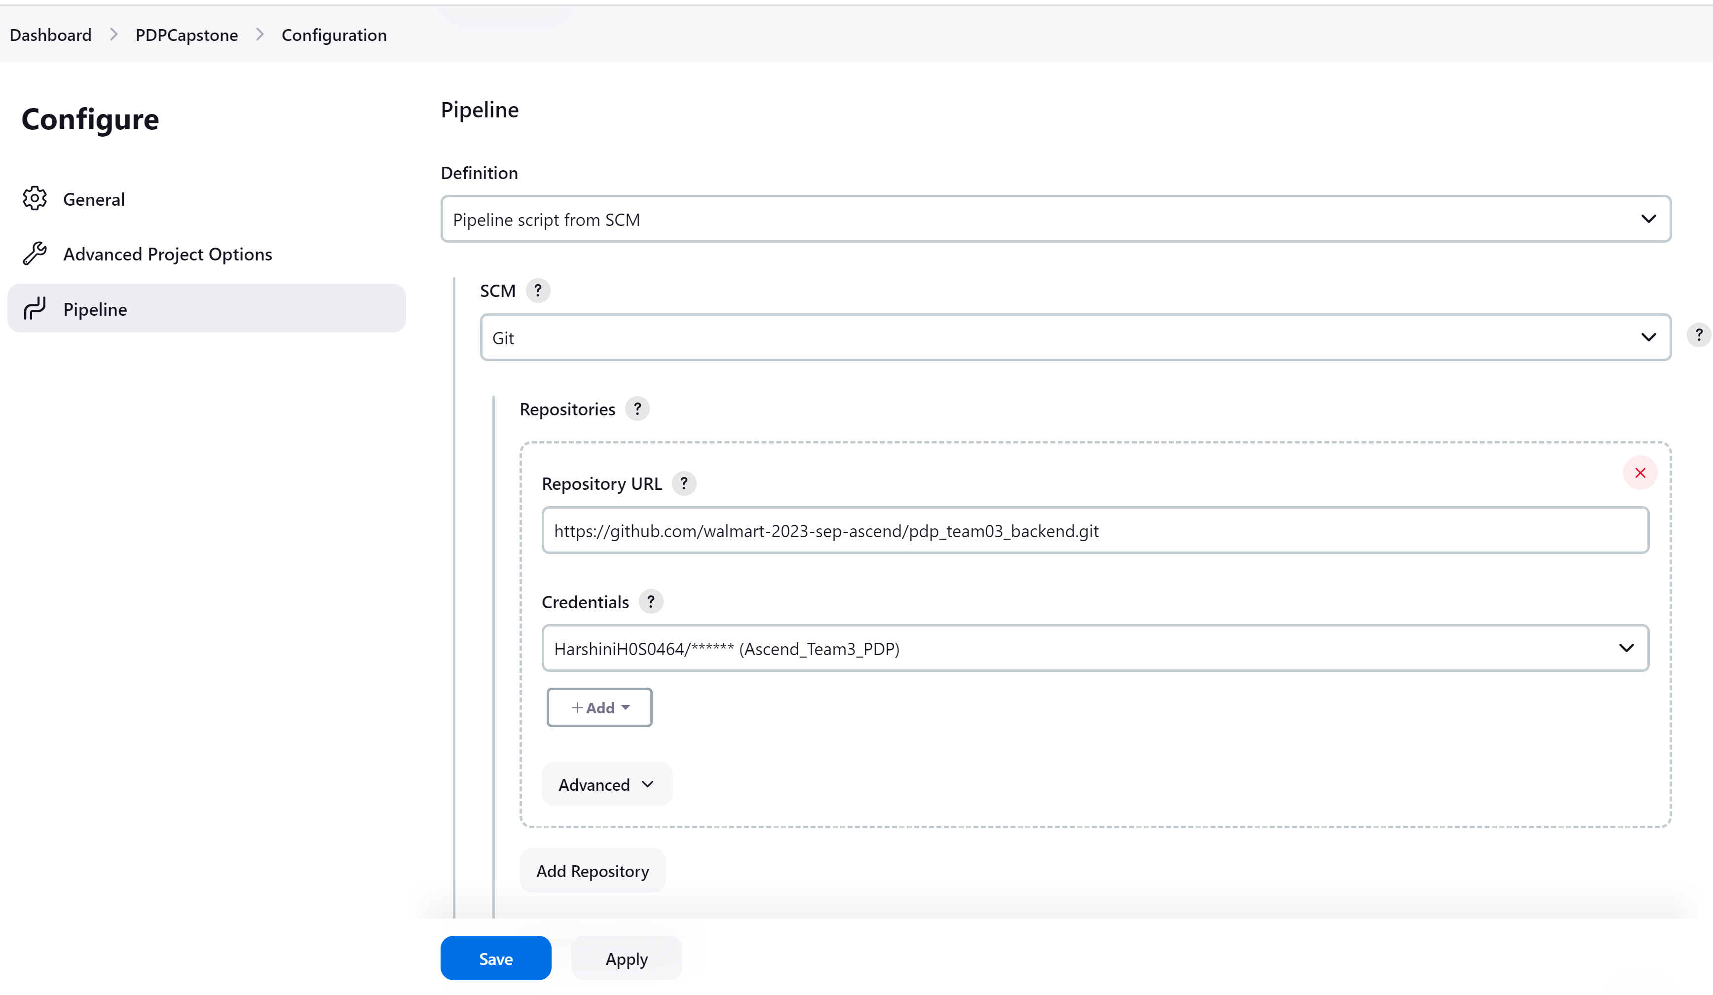
Jenkins Pipeline
Passing the code repo git URL and credentials(Username /Generate PAT for git for access purpose)​
https://github.com/walmart-2023-sep-ascend/pdp_team03_backend

Slide 20
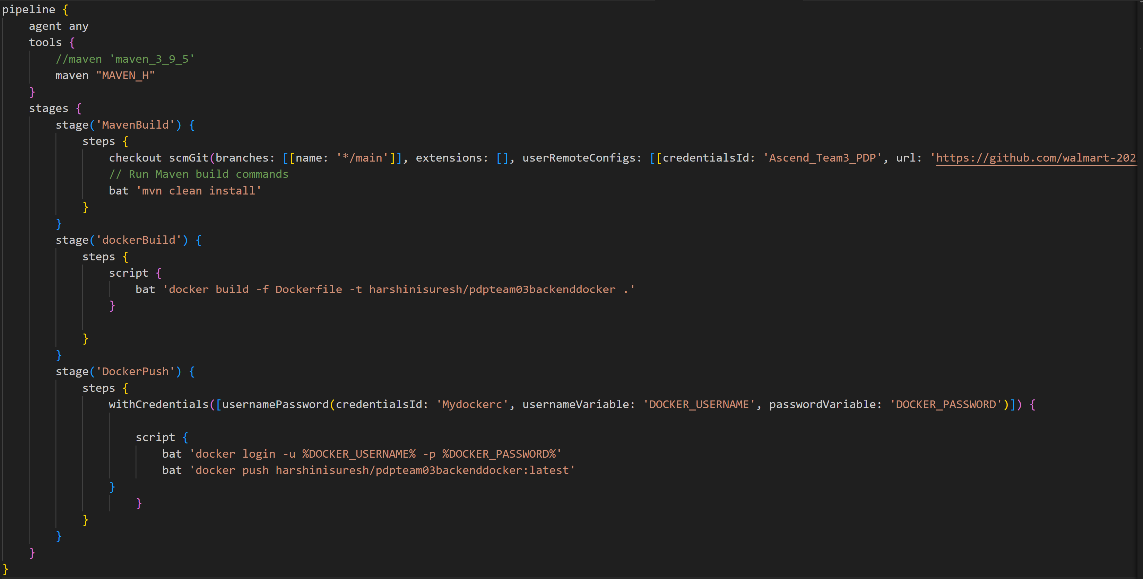
Jenkins File

Slide 21
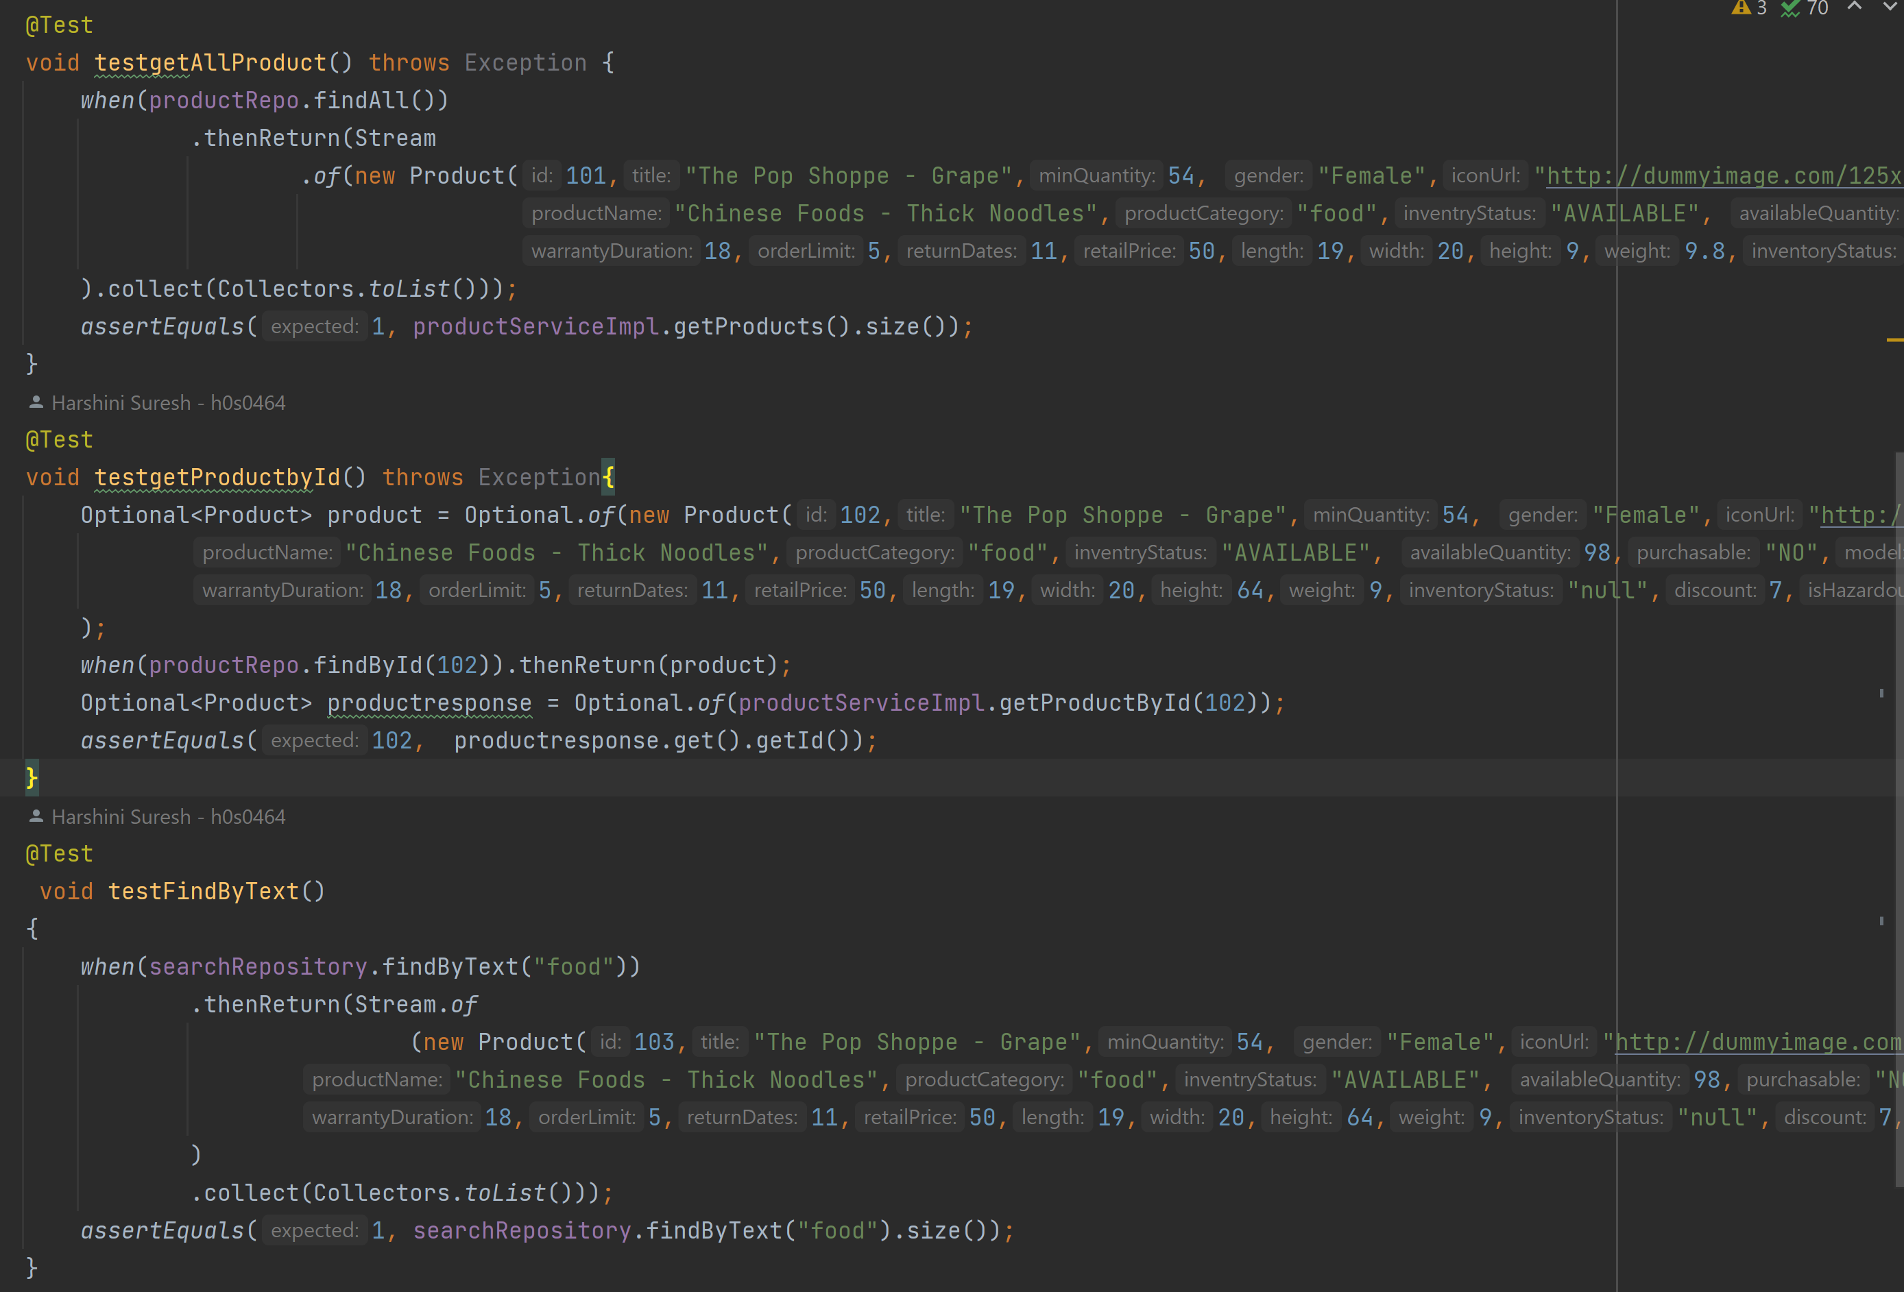
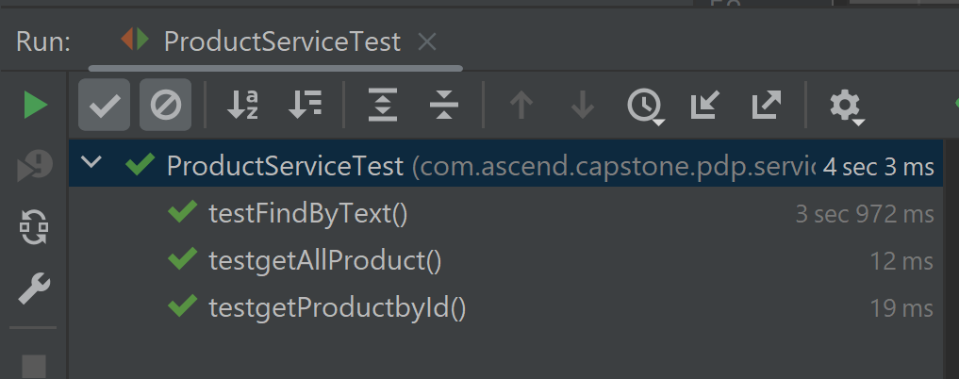
Test Cases Validation

Slide 22
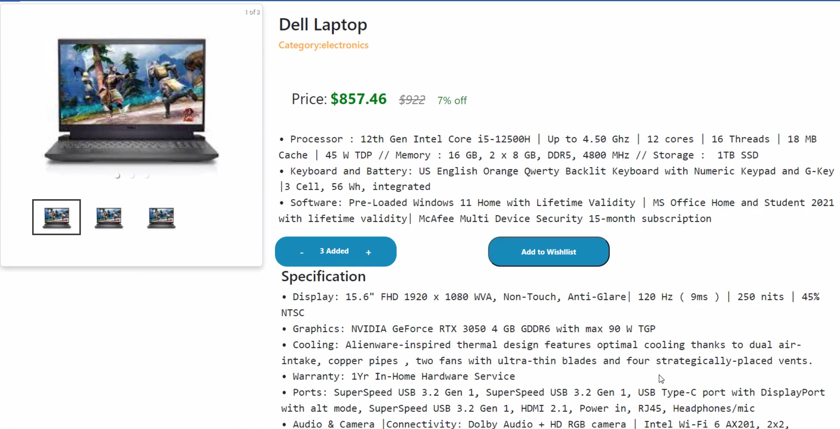
UI Implementation – Product Info / Added to cart

Slide 23
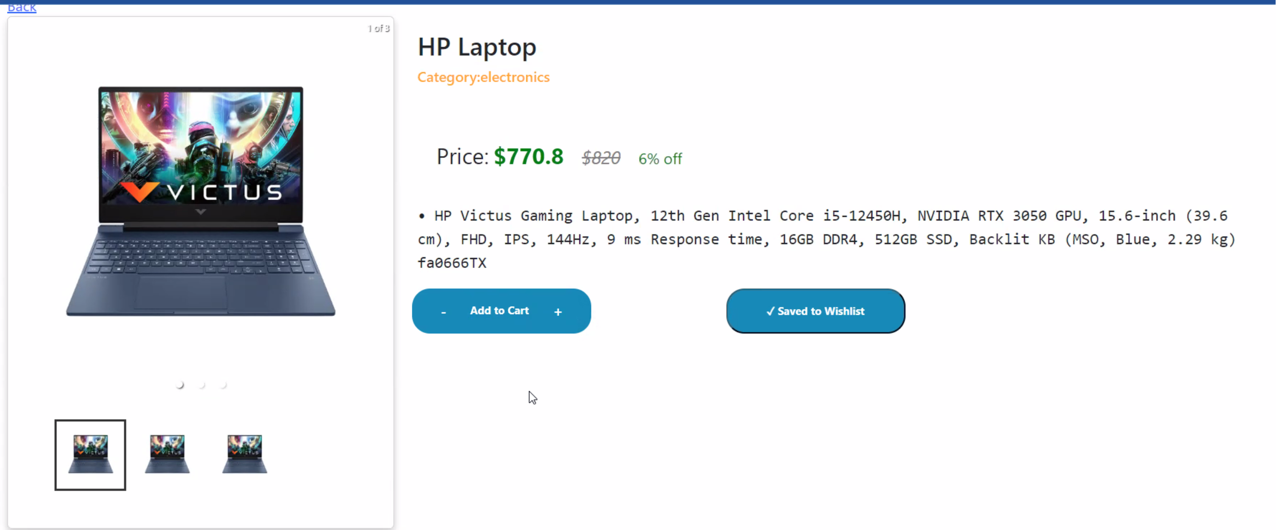
UI Implementation – Saved to Wishlist

Slide 24
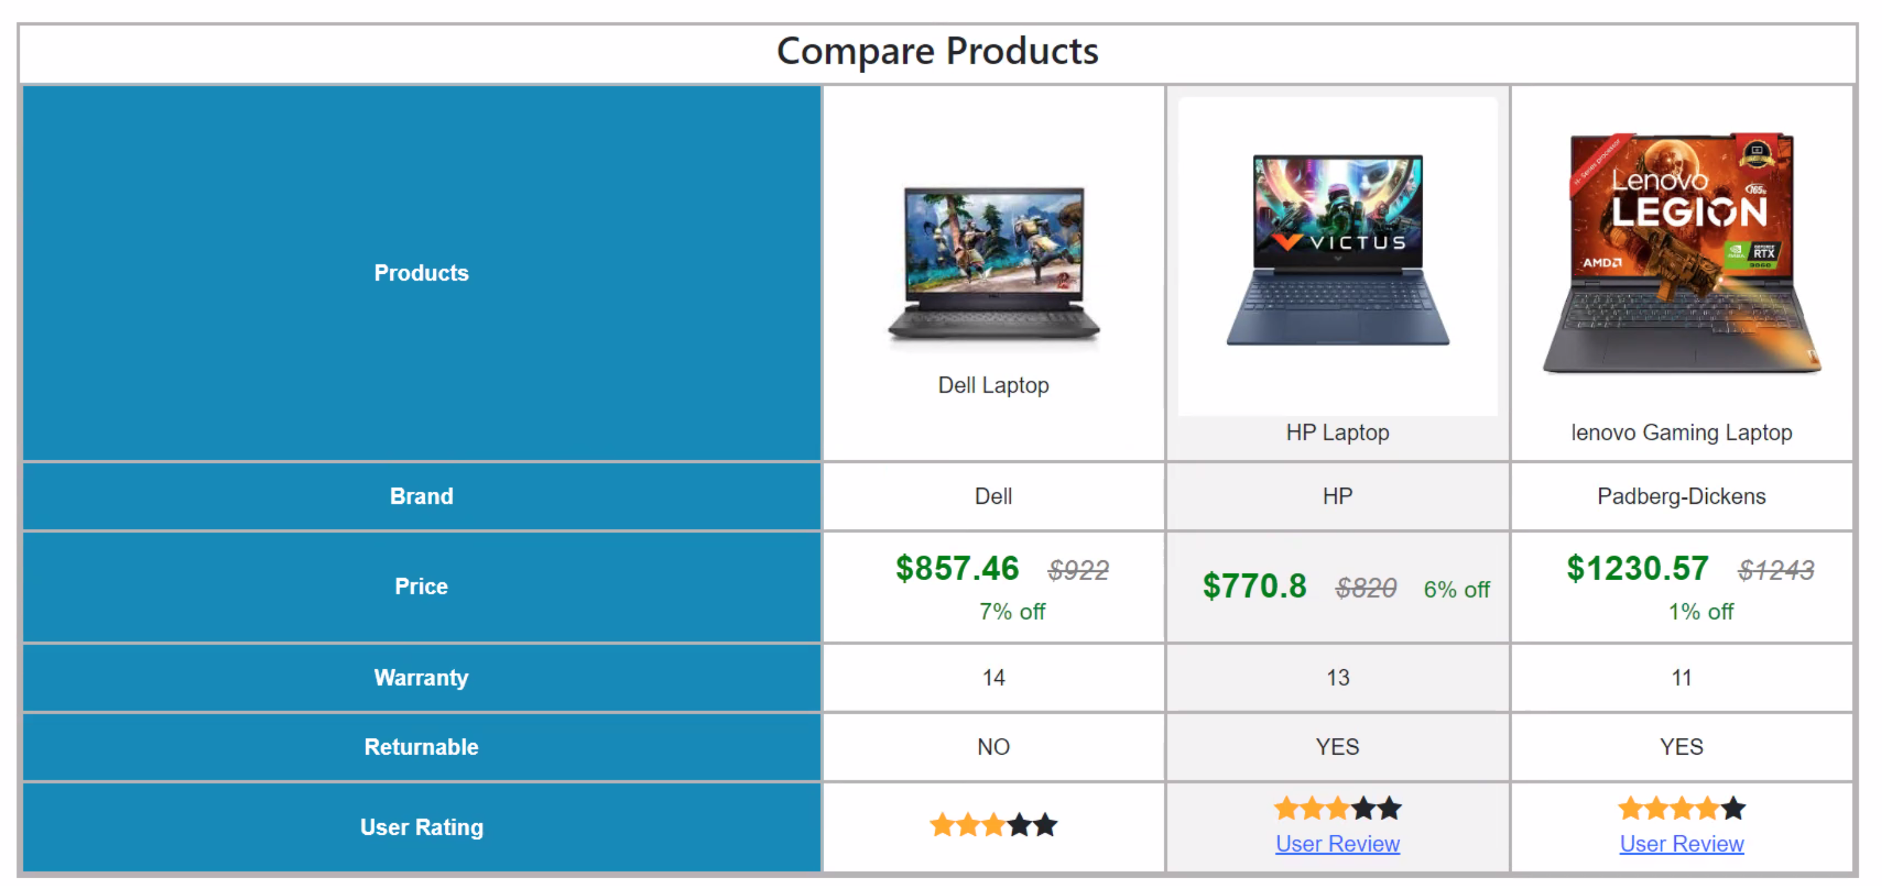
UI Implementation – Compare Products

Slide 25
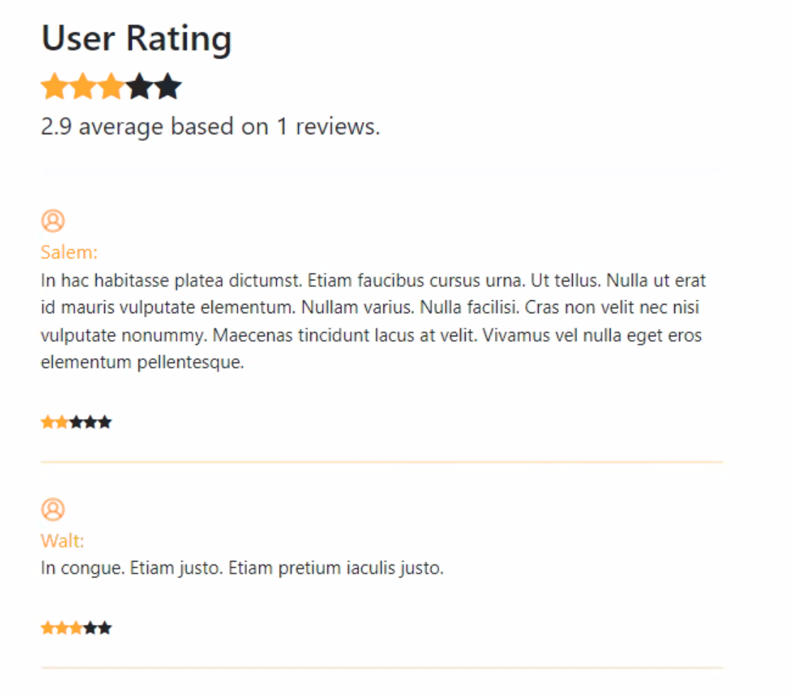
UI Implementation – User Rating

Slide 26
Learnings & enhancements​
This capstone project is helpful to perform the real hands-on to understand the solutioning and designing of microservice project​
This project is helpful to visualize how a real time project like this will be divided into modules and assigned to multiple associates. Also, how each associates develop their modules but not work in silos since each module is interlinked with other ones​

Slide 27

Thank You ☺

